Slide 1
Home Safety System with Earthquake and Fire Detection Based on Internet of Things
資工碩一
陳子珩 葉桓郡 池宇澄 黃昱凱

Slide 2
Outline
Introduction
Sensors & motors we used
Method
Experiment & Result
Overall cost
Conclusion
Demo video
Reference
Notes:
Your project topic or area your topic might be.
3 to 4 related projects/research papers. Remember to go back to the first lecture on "How to read a (research) paper" and summarize the research papers/related projects.
Problems or challenges you will encounter for your project.
Some of the sensors you might need.
Submit the draft of your presentation slide and report (use IEEE format but you only need to write the related section) before the class. You will be able to resubmit on Week 7 (11/04).

Slide 3



Introduction
Our idea:
When the earthquake occurs, if the door can be opened automatically during an earthquake, it will improve the escape efficiency as well as decrease the possibility of the occurrence of danger.
When a home fire occurs, the system will provide evacuation direction and preventing spread of fire.
The advantages of our design:
For the earthquake part, this design not only calms user’s worry that the door frame is going to be damaged and stocks the escape route but also increases the odds of survival.
For the fire part, the information of the temperature will be provided to the firefighter, the room information will be provided as well.
Monitor home status remotely via Line.

Slide 4
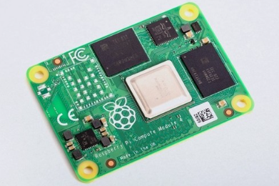
Sensors & motors we used
Raspberry Pi Compute Module 3B+

Slide 5
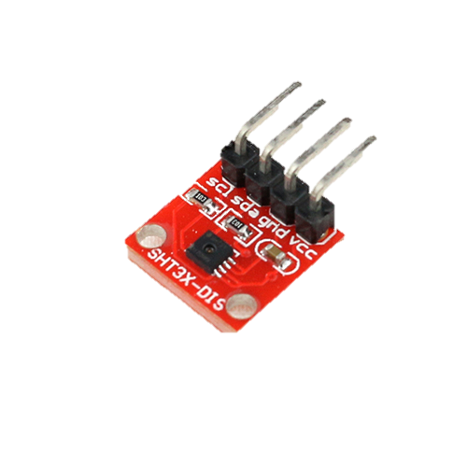
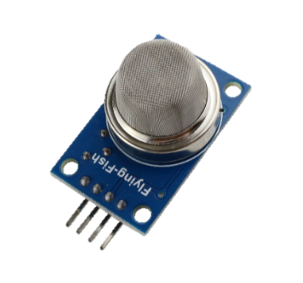
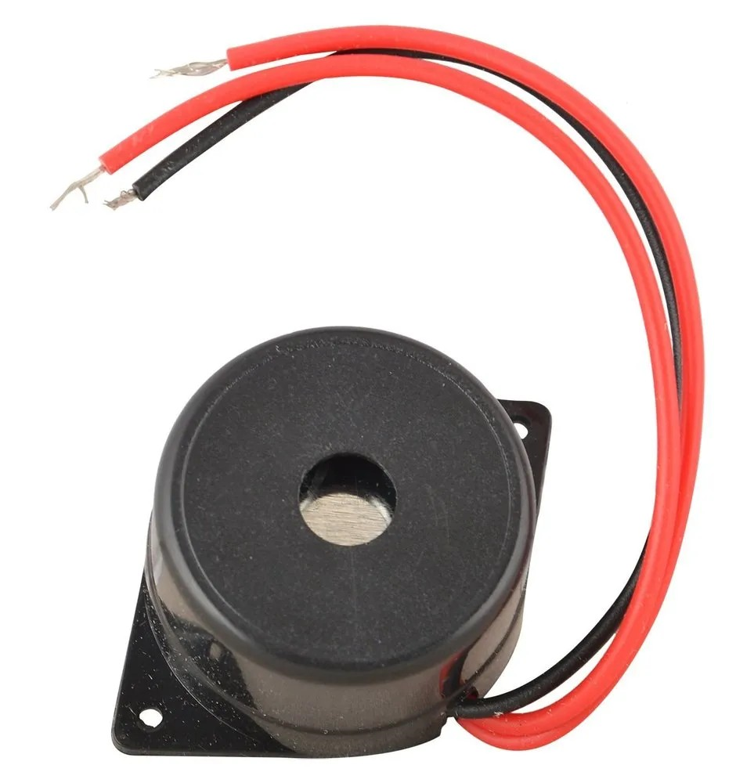


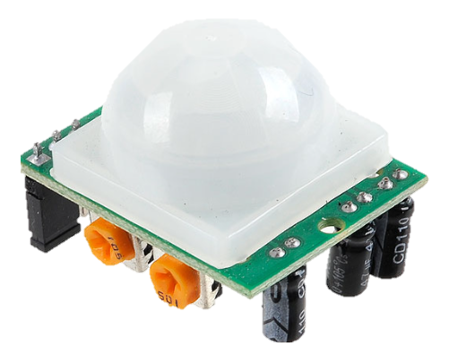
Sensors & Motors We Might Need
Motor *3
SHT31 *1
PIR sensor *3
MQ-2 *6
Buzzer *1
Button *2

Slide 6
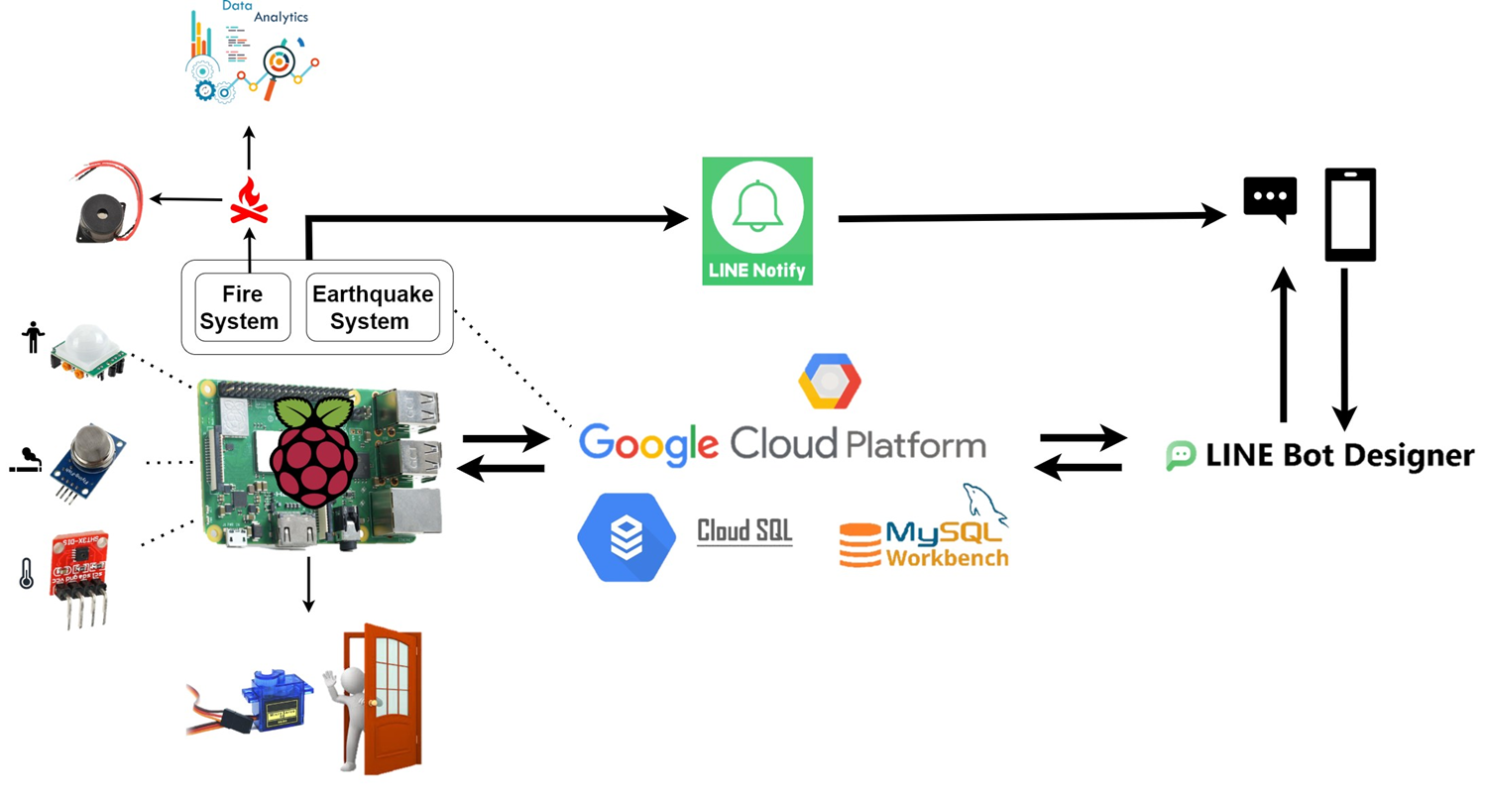
Method
System architecture

Slide 7

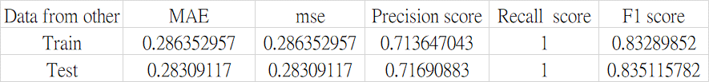
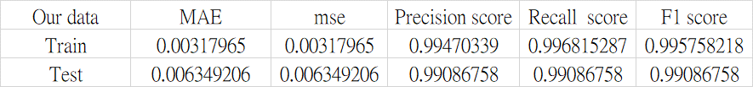
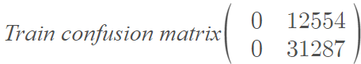
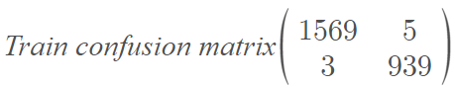
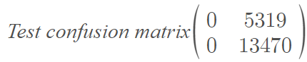
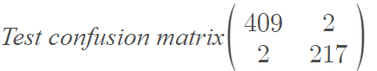
Method
Data analysis-logistic regression
web dataset
Our dataset

Slide 8
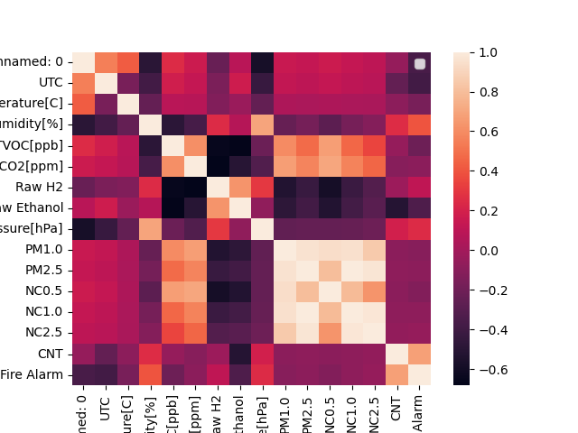
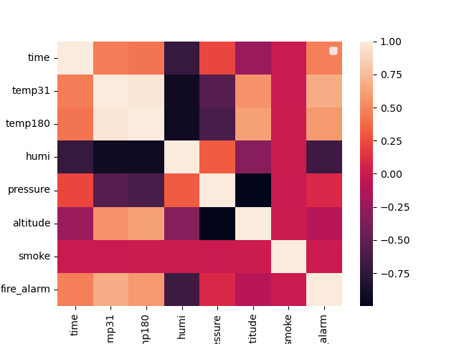
Method
Data analysis-Pearson correlation
web dataset
our dataset

Slide 9
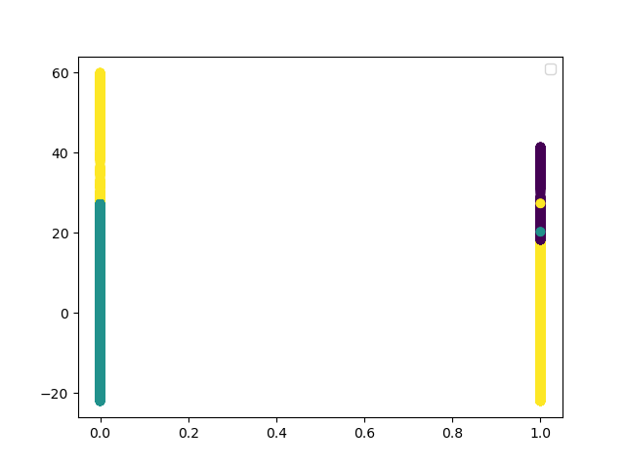
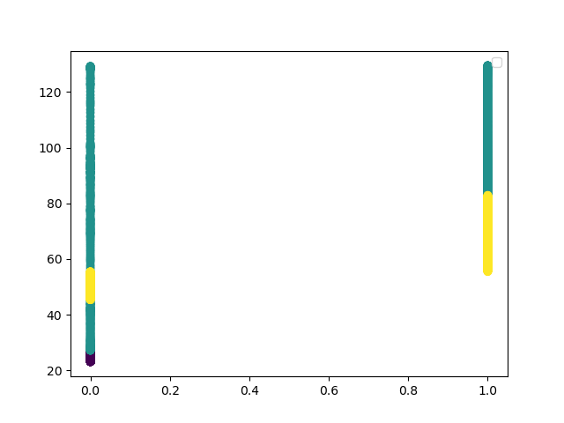
Method
Data analysis-Kmeans (Temp&Fire alarm)
Temp
Temp
Fire alarm
Fire alarm
web dataset
our dataset

Slide 10
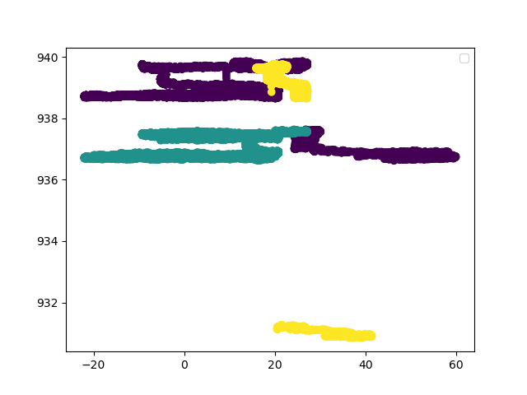
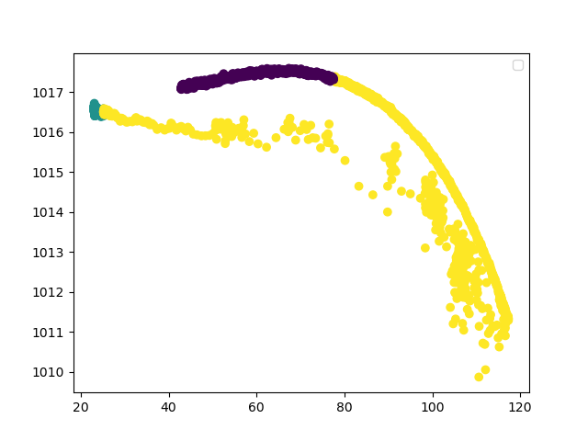
Method
Data analysis- Kmeans (Temp&Pressure)
Pressure
Pressure
Temp
Temp
web dataset
our dataset
9

Slide 11
Method
Data analysis-risk evaluation(our data)
Temp (°C)
Humi (%)

Slide 12
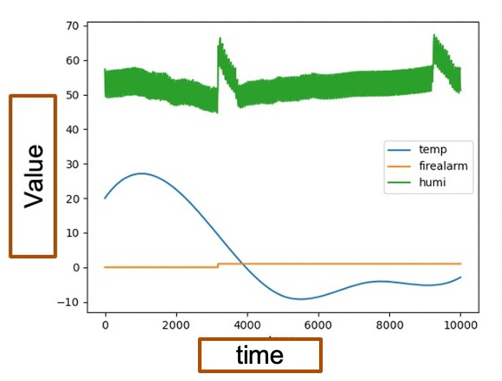
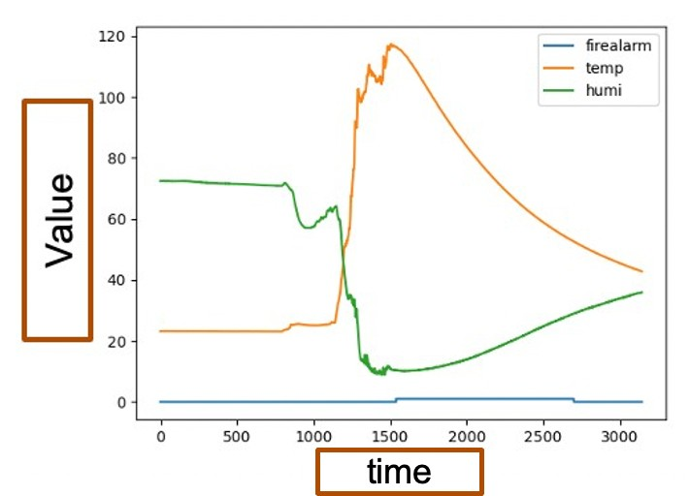
Method
Data analysis-Line chart(temp,fire alarm,humi)
web dataset
our dataset
Notes:
同個溫度有兩個濕度->原因是升溫到降溫都有測到

Slide 13
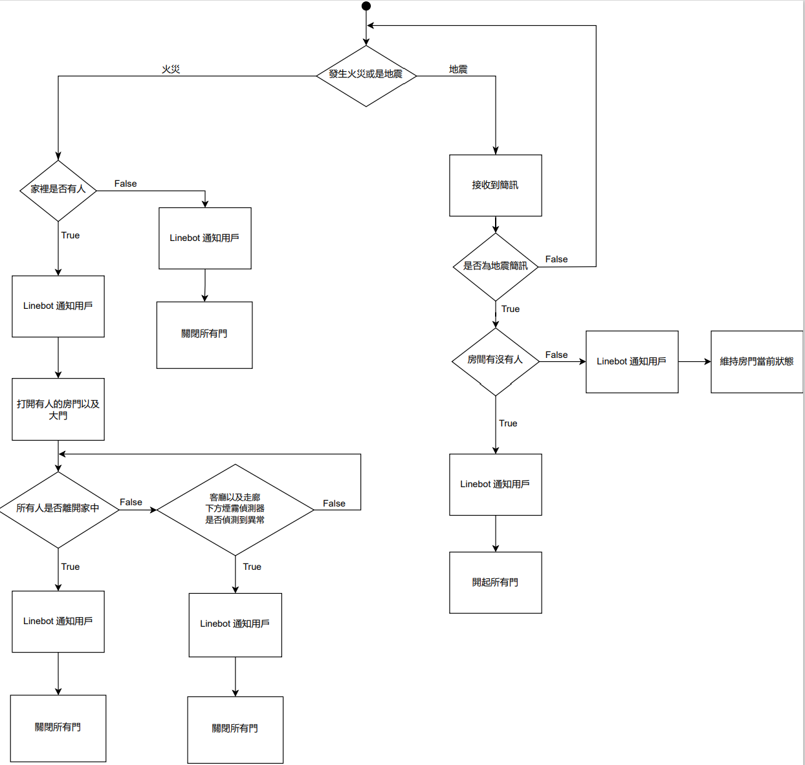
Method- Flow chart

Slide 14

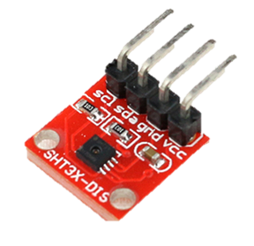
Method- Sensors’ location
大門
Raspberry
客廳
Chih_room
Chih_door
Chen_door
Chen_room
走廊

Slide 15
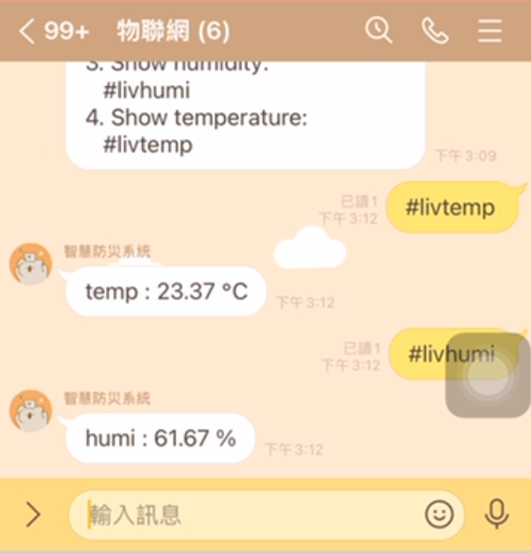
Method
大門
Raspberry
客廳
Chih_room
Chih_door
Chen_door
Chen_room
走廊

Slide 16

Method
大門
Raspberry
客廳
Chih_room
Chih_door
Chen_door
Chen_room
走廊

Slide 17


Method- Earthquake
大門
沒人時不開門
Raspberry
客廳
有人時開啟逃生路線所有的門
Chih_room
Chih_door
Chen_door
Chen_room
走廊

Slide 18
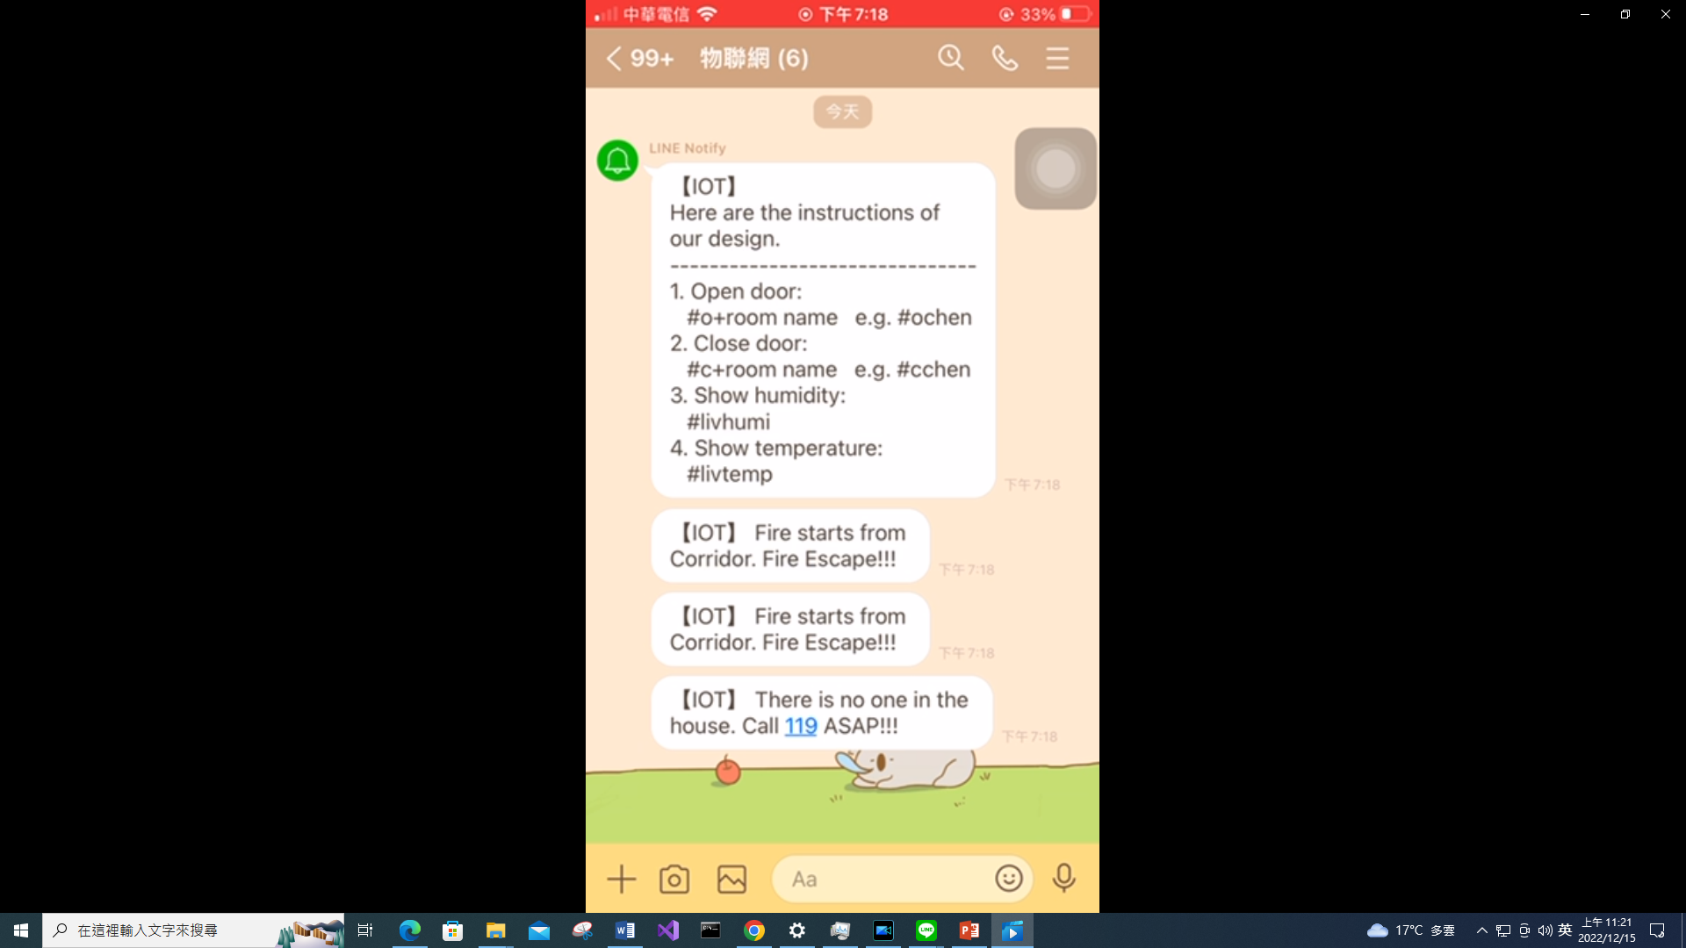

Method- Fire
大門
Raspberry
客廳
Chih_room
Chih_door
Chen_door
Chen_room
走廊
當此時適合逃生時
房間有人，房門打開
順利逃出時，自動將門關上

Slide 19
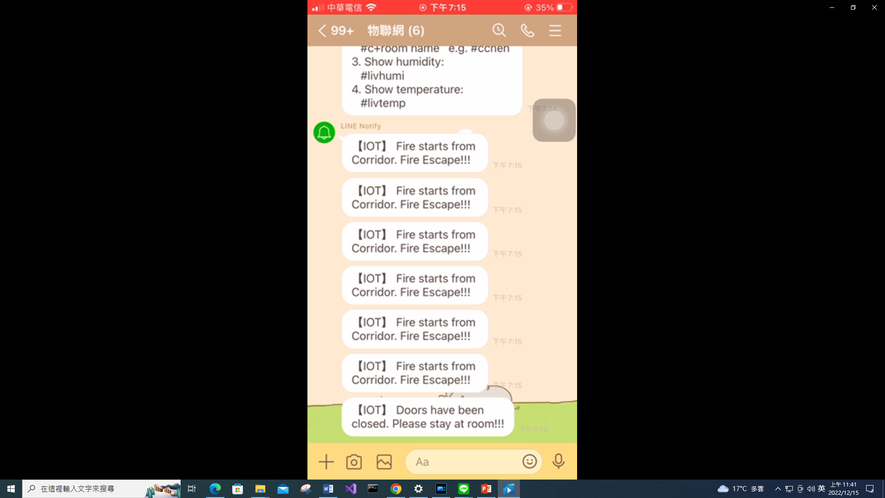
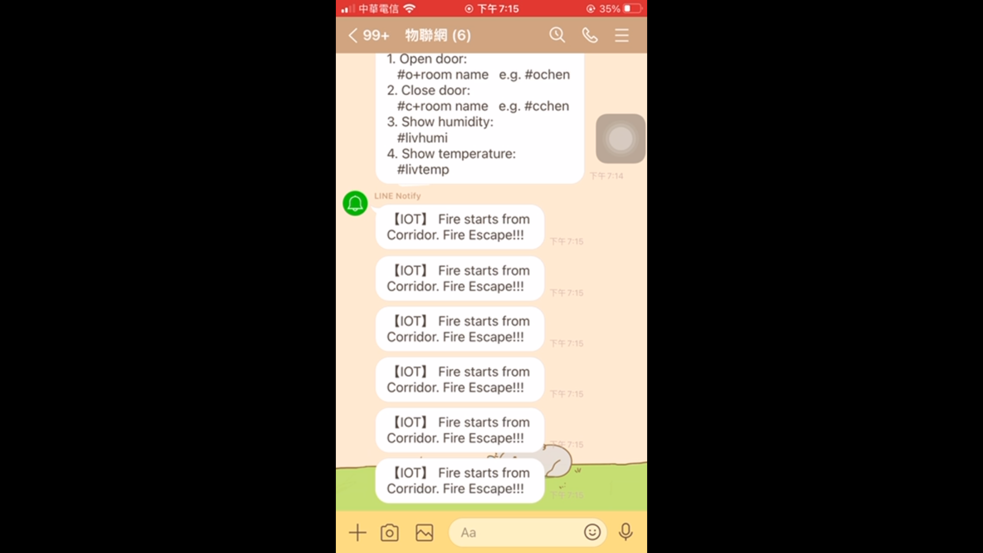

Method- Fire
大門
Raspberry
客廳
Chih_room
Chih_door
Chen_door
Chen_room
走廊

Slide 20
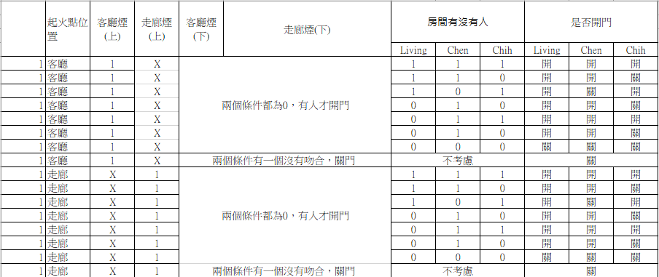
Method
Case table

Slide 21
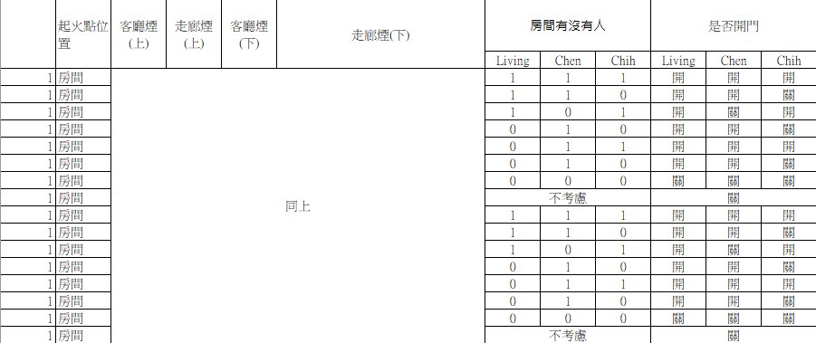
Method
Case table

Slide 22
Method
客廳或是走廊上方煙霧偵測到時，房間若有人就開門。
客廳或是走廊上方以及下方煙霧偵測到時，房間關門。
若全部房間都沒有人時，全部的門關上。

Slide 23


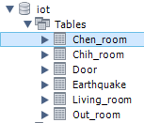
Method
Database
GCP(SQL)
MySQL Workbench

Slide 24


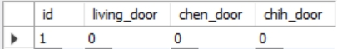
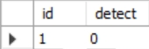
Method
Database
Living_room 客廳監控
Chen_room/Chih_room 房內監控
Door 控制門開關
Earthquake
Out_room 走廊監控

Slide 25


Method
LineBot 前置作業
建立在GCP server上
與GCP SQL串接並與IOT溝通
使用ngrok讓外網連結API
LINE Developer Webhook+ngrok串接
下載LinebotSDK函式庫

Slide 26

Method
LineBot 主要功能
接收使用者訊息並配對(re.match)
配對到正確指令搜尋資料庫抓取內容或更新內容執行指令
回傳對話給使用者(reply)
* 因資料庫最終更新內容預設為陣列最後一個索引，所以需要抓取指 定欄位並獲取最後一個索引值

Slide 27
Method
LineBot 遇到之問題
問題 : 無法在沒接收到指令的狀況下”主動回傳訊息”給使用者
Request & Post的問題(沒接收到指令)
Line訊息封包格式問題
若用排程法會造成卡在迴圈內的問題(可能接收不到指令)
解決方式 : 使用Line Notify解決
只要傳送資料給Line Notify帳號(Request)
就會直接從Line Notify發通知給使用者(Post)

Slide 28


Experiment & Result
Choose 50 cases from case table randomly.
Accuracy: 98% (Successful: 49, Failed: 1)
The reason for the failed one is the motor issue.
49
1

Slide 29
Overall cost
Raspberry Pi Compute Module 3B+ $5600
Motor $350
MQ-2 $200
SHT31 $250
Buzzer & Button $60
Experiment Materials $1000
Demo Sample $400
Approximate Total $7860

Slide 30
Conclusion
本系統能夠協助使用者在地震或火災發生時，提升順利逃出的機會並協助消防人員監控火災時每個房間的情況，以利判斷更好的救援方式。
若是運用在生活中，建議將每個sensor都透過無線連接的方式連至server，以降低火災發生時將線路燒壞的風險。
在架設每個sensor時，建議安裝防火的外殼，以免火災發生時損壞其功用。
可改為透過偵測CO2濃度的方式來判斷家裡有沒有人。

Slide 31
Reference
[1] S.K.McBridea, A.Bostrom, J.Sutton, R.M.de Groota, A.S.Baltaya, B.Terbush, P.Bodine, M.Dixon, E.Holland, R.Arba, P.Laustsen,S.Liu and M.Vinci, “Developing post-alert messaging for ShakeAlert, the earthquake early warning system for the West Coast ofthe United States of America,” International Journal of Disaster Risk Reduction, vol. 50, Nov 2020.
[2] A. Hasibuan, R. Rosdiana, and D. S. Tambunan, “Design and Development of An Automatic Door Gate Based on Internet of Things Using Arduino Uno”, Bulletin of Comp. Sci. Electr. Eng., vol. 2, no. 1, pp. 17–27, Jun. 2021.
[3] Downs, Steven; Pollo, Ardian; and Bredemeier, Ethan, "Residential Automatic Door Opener" (2018). Mechanical Engineering Design Project Class. 94.
[4] EZ-Access, image of CONCIERGE® Residential Power Door Opener, EZ-Access.
https://www.ezaccess.com/products/concierge-residential-power-door-opener

Slide 32
Demo video
https://www.youtube.com/watch?v=G00AB_hBpFA

Slide 33
Thanks For Listening

